Slide 1
HNDIT24012 Computer Architecture
Week 4: Pipelining

Slide 2
Instruction pipelining
Instruction pipelining is a technique that implements a form of parallelism called instruction-level parallelism within a single processor. It therefore allows faster CPU throughput (the number of instructions that can be executed in a unit of time) than would otherwise be possible at a given clock rate. The basic instruction cycle is broken up into a series called a pipeline. Rather than processing each instruction sequentially (finishing one instruction before starting the next), each instruction is split up into a sequence of steps so different steps can be executed in parallel and instructions can be processed concurrently (starting one instruction before finishing the previous one).

Slide 3
Instruction pipelining…
Pipelining increases instruction throughput by performing multiple operations at the same time, but does not reduce instruction latency, which is the time to complete a single instruction from start to finish, as it still must go through all steps. Indeed, it may increase latency due to additional overhead from breaking the computation into separate steps and worse, the pipeline may stall (or even need to be flushed), further increasing the latency. Thus, pipelining increases throughput at the cost of latency, and is frequently used in CPUs but avoided in real-time systems, in which latency is a hard constraint.

Slide 4
Improved Performance
But not doubled:
Fetch usually shorter than execution (cf. reading and storing operands)
Prefetch more than one instruction?
Any jump or branch means that prefetched instructions are not the required instructions
Add more stages to improve performance
Notes:
37

Slide 5
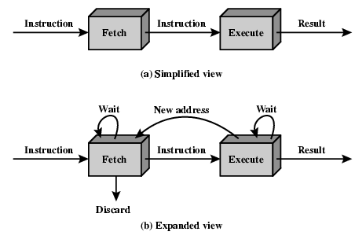
Two Stage Instruction Pipeline

Slide 6
Pipelining (six stages)
Fetch instruction
Decode instruction
Calculate operands (i.e., EAs)
Fetch operands
Execute instructions
Write result
Overlap these operations
Notes:
38

Slide 7
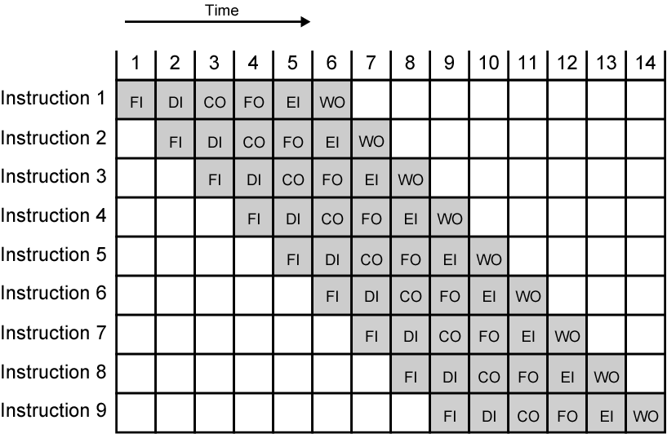
Timing Diagram for Instruction Pipeline Operation (assuming independence)
Notes:
39

Slide 8
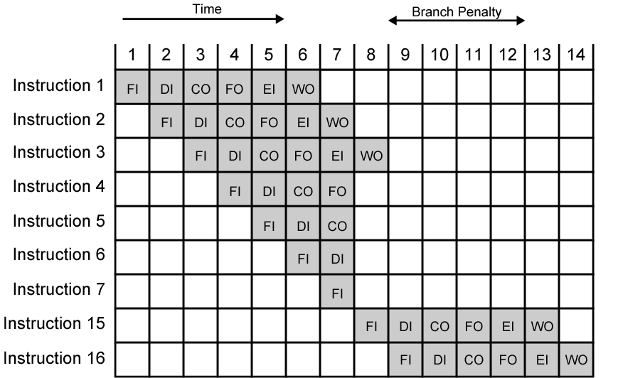
The Effect of a Conditional Branch/Interrupt on Instruction Pipeline Operation
Notes:
40

Slide 9
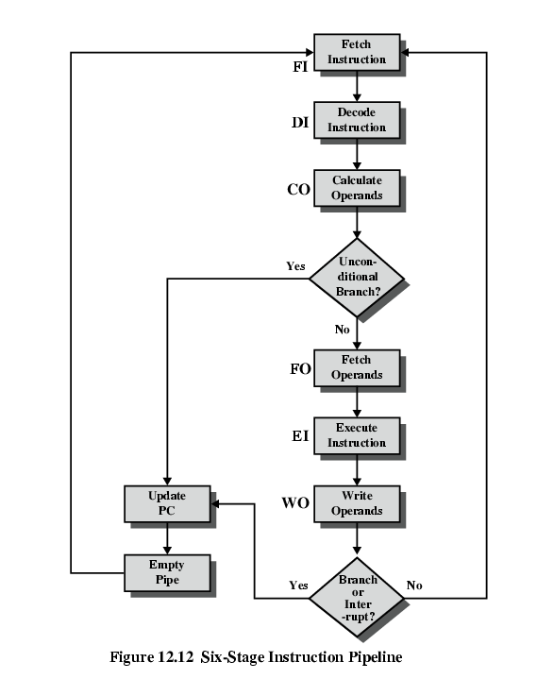
Six Stage Instruction Pipeline

Slide 10
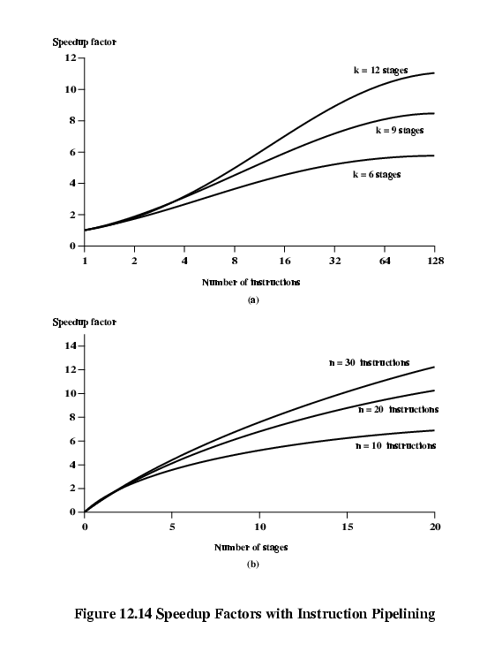
Speedup Factors with Instruction Pipelining: nk/(n+k-1) (ideally)

Slide 11
Dealing with Branches
Prefetch Branch Target
Loop buffer
Branch prediction
Delayed branching (see RISC)
Notes:
41

Slide 12
Prefetch Branch Target
Target of branch is prefetched in addition to instructions following branch
Keep target until branch is executed
Used by IBM 360/91
Notes:
43

Slide 13
Loop Buffer
Very fast memory
Maintained by fetch stage of pipeline
Check buffer before fetching from memory
Very good for small loops or jumps
cf. cache
Notes:
44

Slide 14
Branch Prediction (1)
Predict never taken
Assume that jump will not happen
Always (almost) fetch next instruction
VAX will not prefetch after branch if a page fault would result (OS v CPU design)
Predict always taken
Assume that jump will happen (at least 50%)
Always fetch target instruction
Notes:
45

Slide 15
Branch Prediction (2)
Predict by Opcode
Some instructions are more likely to result in a jump than others
Can get up to 75% success
Taken/Not taken switch
Based on previous history
Good for loops
Delayed branch – rearrange instructions (see RISC)
Notes:
46

Slide 16
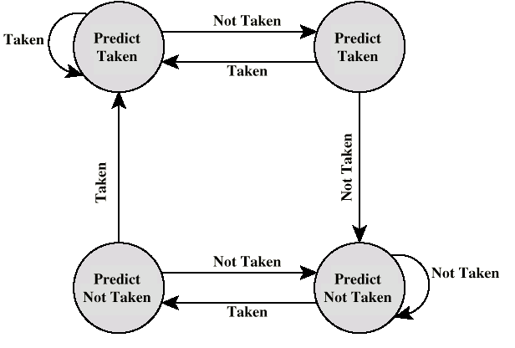
Branch Prediction State Diagram (two bits)

Slide 17
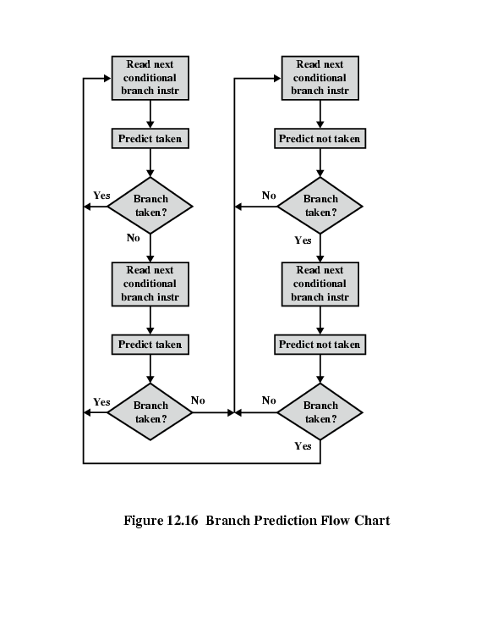
Branch Prediction Flowchart

Slide 18
Intel 80486 Pipelining
Fetch
Put in one of two 16-byte prefetch buffers
Fill buffer with new data as soon as old data consumed
Average 5 instructions fetched per load (variable size)
Independent of other stages to keep buffers full
Decode stage 1
Opcode & address-mode info
At most first 3 bytes of instruction needed for this
Can direct D2 stage to get rest of instruction
Decode stage 2
Expand opcode into control signals
Computation of complex addressing modes
Execute
ALU operations, cache access, register update
Writeback
Update registers & flags
Results sent to cache

Slide 19
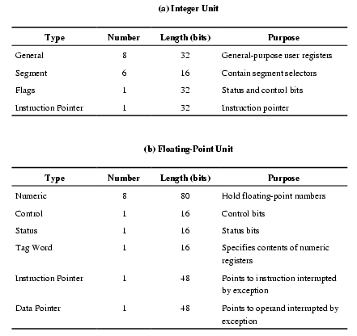
Pentium 4 Registers

Slide 20
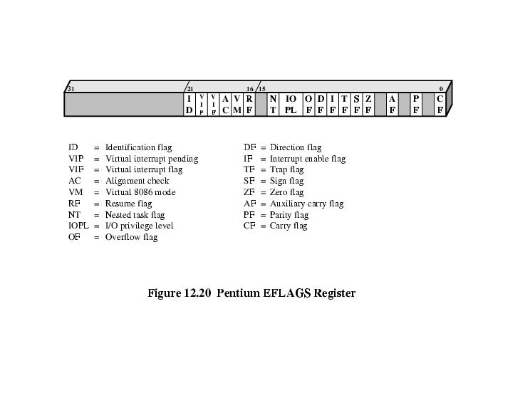
EFLAGS Register

Slide 21
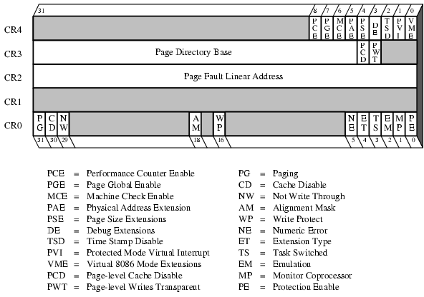
Control Registers

Slide 22
Pentium Interrupt Processing
Interrupts (hardware): (non-)maskable
Exceptions (software): processor detected (error) or programmed (exception)
Interrupt vector table
Each interrupt type assigned a number
Index to vector table
256 * 32 bit interrupt vectors (address of ISR)
5 priority classes: 1. exception by previous instruction 2. external interrupt, 3.-5. faults from fetching, decoding or executing instruction

Slide 23
Introduction to pipeline hazard
Structural Hazard
Data Hazard
Control Hazard

Slide 24
Pipeline Hazards (1)
Pipeline Hazards are situations that prevent the next instruction in the instruction stream from executing in its designated clock cycle
Hazards reduce the performance from the ideal speedup gained by pipelining
Three types of hazards
Structural hazards
Arise from resource conflicts when the hardware can’t support all possible combinations of overlapping instructions
Data hazards
Arise when an instruction depends on the results of a previous instruction in a way that is exposed by overlapping of instruction in pipeline
Control hazards
Arise from the pipelining of branches and other instructions that change the PC (Program Counter)

Slide 25
Pipeline Hazards (2)
Hazards in pipeline can make the pipeline to (pipeline)stall
a bubble or pipeline stall is a delay in execution of an instruction in an instruction pipeline in order to resolve a hazard.
Eliminating a hazard often requires that some instructions in the pipeline to be allowed to proceed while others are delayed
When an instruction is stalled, instructions issued latter than the stalled instruction are stopped, while the ones issued earlier must continue
No new instructions are fetched during the stall

Slide 26
Structural Hazards (1)
If certain combination of instructions can’t be accommodated because of resource conflicts, the machine is said to have a structural hazard
It can be generated by:
Some functional unit is not fully pipelined
Some resources has not been duplicated enough to allow all the combinations in the pipeline to execute
For example: a machine may have only one register file write port, but under certain conditions, the pipeline might want to perform two writes in one clock cycle – this will generate structural hazard
When a sequence of instructions encounter this hazard, the pipeline will stall one of the instructions until the required unit is available
Such stalls will increase the Clock cycle Per Instruction from its ideal 1 for pipelined machines

Slide 27
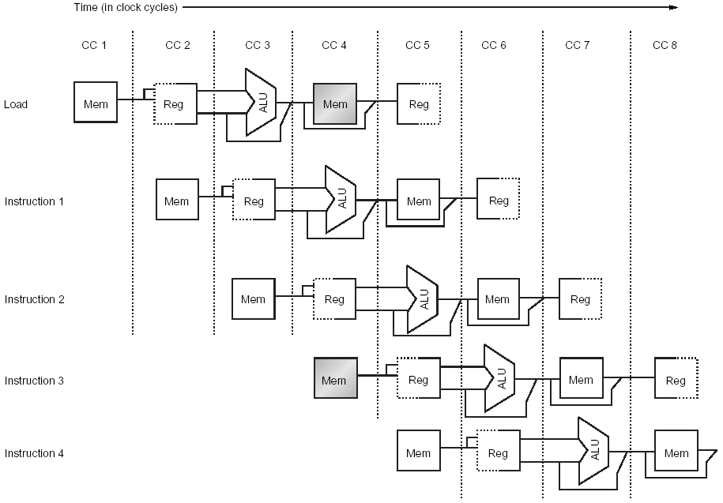
Structural Hazards (2)
Consider a Von Neumann architecture (same memory for instructions and data)
Notes:
As a result, when an instruction will perform a data reference, will conflict with an instruction fetch.
In this example, the load instruction wants to access the memory to load data at the same time when instruction 3 wants to fetch an instruction from memory.

Slide 28
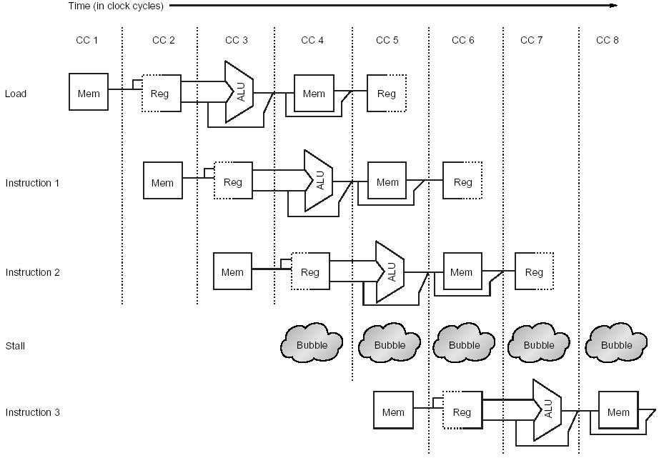
Structural Hazards (3)
Stall cycle added (commonly called pipeline bubble)
Notes:
To solve the problem, a stall cycle is added. The effect of the pipeline bubble is actually to occupy the resources for that instruction slot as it travels through the pipeline. Performance wise, instruction 3 will not complete during clock cycle 8, but during clock cycle 9.

Slide 29
Structural Hazards (4)
Instruction Number | Clock number
 | 1 | 2 | 3 | 4 | 5 | 6 | 7 | 8 | 9 | 10
load | IF | ID | EX | MEM | WB
Instruction i+1 |  | IF | ID | EX | MEM | WB
Instruction i+2 |  |  | IF | ID | EX | MEM | WB
Instruction i+3 |  |  |  | stall | IF | ID | EX | MEM | WB
Instruction i+4 |  |  |  |  |  | IF | ID | EX | MEM | WB
Instruction i+5 |  |  |  |  |  |  | IF | ID | EX | MEM
Another way to represent the stall – no instruction is initiated in clock cycle 4
Notes:
Sometime those diagrams are drawn with a stall occupying a whole raw, with instruction 3 being moved to the next raw. In either case, the effect is the same. The instruction 3 is not beginning execution until cycle 5.

Slide 30
Structural Hazards (5)
A machine with structural hazard will have lower Cycle per instruction.
Why a designer allows structural hazard?
To reduce cost
Pipelining all the functional units or duplicating them may be too costly
To reduce latency
Introducing too many pipeline stages may cause latency issues

Slide 31
Data Hazards (1)
Data hazards occur when the pipeline changes the order of read/write accesses to operands so that the order differs from the order seen by sequentially executing instructions on an un-pipelined machine
Consider the execution of following instructions, on our pipelined example processor:
ADD R1, R2, R3
SUB R4, R1, R5
AND R6, R1, R7
OR R8, R1, R9
XOR R10, R1, R11
Notes:
All the instructions after ADD use the result from ADD.

Slide 32
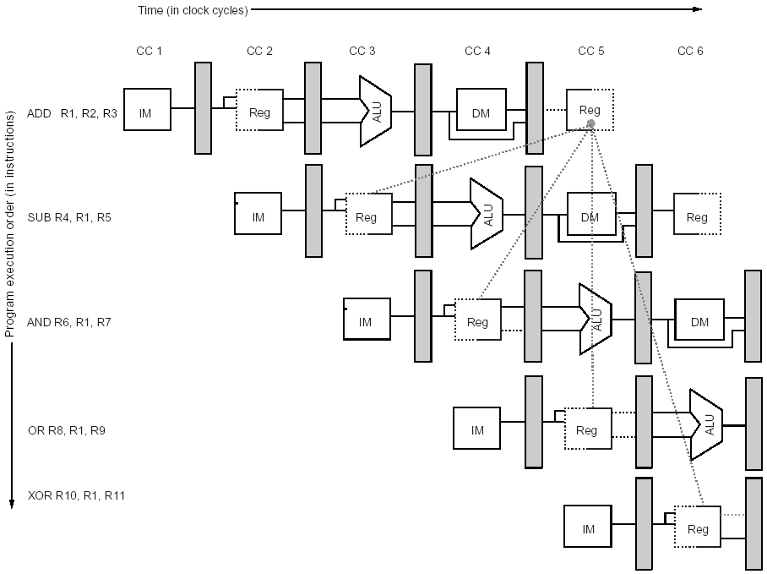
Data Hazards (2)
The use of results from ADD instruction causes hazard since the register is not written until after those instructions read it.
Notes:
The ADD instruction writes the result in register R1 only at the WB stage, but SUB instruction reads the value during its ID stage. This is what is called a data hazard. Unless precautions are taken, the SUB instruction will read the wrong value and will use it…
The AND instruction is also affected by this hazard. As we can see from the figure, the write of R1 doesn’t complete until the end of clock cycle 5. Thus, the AND instruction that reads the registers in clock cycle 4 will receive the wrong results.
XOR instruction operates correctly, it reads its inputs (in clock cycle 6) after the ADD has written its result (in clock cycle 5). OR instruction can also be made to work without incurring an hazard, using a simple implementation technique. The technique is to perform the register file reads in the second half of the clock cycle and the writes in the first half.

Slide 33

Data Hazards (3)
Eliminate the stalls for the hazard involving SUB and AND instructions using a technique called forwarding
Notes:
The data hazard, in certain circumstances can be solved using an implementation technique called forwarding. The idea behind the forwarding is that the result produced by ADD is not really needed by the SUB instruction until it is actually produced. If the result can be moved from where the ADD instruction produces it , the EX/MEM register, to where the SUB needs it, the ALU input latches, then the need for a stall can be avoided.
Forwarding works as follow:
The ALU result from EX/MEM register is always fed back to the ALU input latches
If the forwarding hardware detects that the previous ALU operation has written the register corresponding to a source for the current ALU operation, control logic selects the forwarded result as the ALU input, rather than the value read from the register file.
We need to forward results not only from immediately previous instruction, but possible from instructions that started two or three cycles earlier.

Slide 34
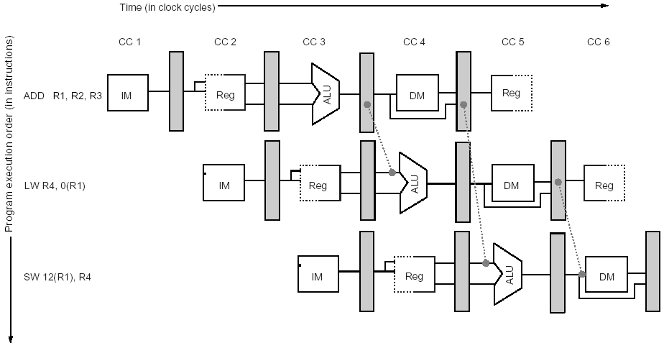
Data Hazards (4)
Store requires an operand during MEM and forwarding is shown here.
The result of the load is forwarded from the output in MEM/WB to the memory input to be stored
In addition the ALUOutput is forwarded to ALU input for address calculation for both Load and Store

Slide 35
Data Hazards Classification
Depending on the order of read and write access in the instructions, data hazards could be classified as three types.
Consider two instructions i and j, with i occurring before j. Possible data hazards:
RAW (Read After Write)
j tries to read a source before i writes to it , so j incorrectly gets the old value;
most common type of hazard, that is what we tried to explain so far.
WAW (Write After Write)
j tries to write an operand before is written by i. The write ends up being performed in wrong order, having i overwrite the operand written by j, the destination containing the operand written by i rather than the one written by j
Present in pipelines that write in more than one pipe stage
WAR (Write After Read)
j tries to write a destination before it is read by i, so the instruction i incorrectly gets the new value
This doesn’t happen in our example, since all reads are early and writes late

Slide 36
Data Hazards Requiring Stalls (1)
Unfortunately not all data hazards can be handled by forwarding. Consider the following sequence:
LW R1, 0(R2)
SUB R4, R1, R5
AND R6, R1, R7
OR R8, R1, R9
The problem with this sequence is that the Load operation will not have data until the end of MEM stage.

Slide 37
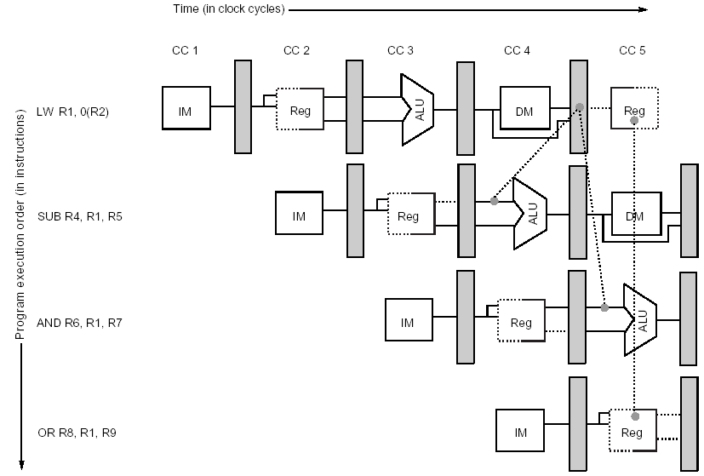
Data Hazards Requiring Stalls (2)
The load instruction can forward the results to AND and OR instruction, but not to the SUB instruction since that would mean forwarding results in “negative” time

Slide 38
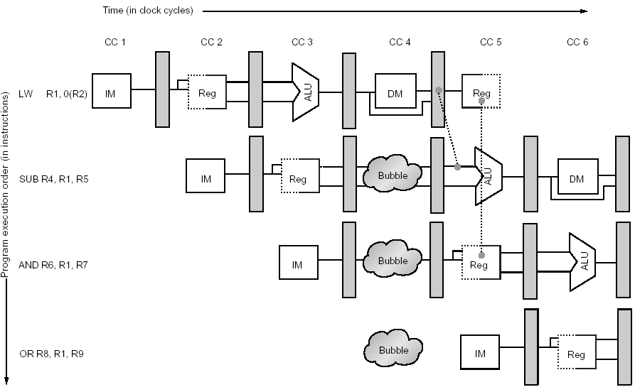
Data Hazards Requiring Stalls (3)
The load interlock causes a stall to be inserted at clock cycle 4, delaying the SUB instruction and those that follow by one cycle.
This delay allows the value to be successfully forwarded onto the next clock cycle

Slide 39
Data Hazards Requiring Stalls (4)
LW R1, 0(R2) | IF | ID | EX | MEM | WB
SUB R4, R1, R5 |  | IF | ID | EX | MEM | WB
AND R6, R1, R7 |  |  | IF | ID | EX | MEM | WB
OR R8, R1, R9 |  |  |  | IF | ID | EX | MEM | WB
Before stall insertion
LW R1, 0(R2) | IF | ID | EX | MEM | WB
SUB R4, R1, R5 |  | IF | ID | stall | EX | MEM | WB
AND R6, R1, R7 |  |  | IF | stall | ID | EX | MEM | WB
OR R8, R1, R9 |  |  |  | stall | IF | ID | EX | MEM | WB
After stall insertion

Slide 40
Compiler Scheduling for Data Hazards
Consider a typical code, such as A = B+C
LW R1, B | IF | ID | EX | MEM | WB
LW R2, C |  | IF | ID | EX | MEM | WB
ADD R3, R1, R2 |  |  | IF | ID | stall | EX | MEM | WB
SW A, R3 |  |  |  | IF | stall | ID | EX | MEM | WB
The ADD instruction must be stalled to allow the load of C to complete
The SW needs not be delayed because the forwarding hardware passes the result from MEM/WB directly to the data memory input for storing

Slide 41
Compiler Scheduling for Data Hazards
Rather than just allow the pipeline to stall, the compiler could try to schedule the pipeline to avoid the stalls, by rearranging the code
The compiler could try to avoid the generating the code with a load followed by an immediate use of the load destination register
This technique is called pipeline scheduling or instruction scheduling and it is a very used technique in modern compilers

Slide 42
Instruction scheduling example
Generate code for our example processor that avoids pipeline stalls from the following sequence:
A = B +C
D = E - F
Solution
LW Rb, B
LW Rc, C
LW Re, E ; swap instructions to avoid stall
ADD Ra, Rb, Rc
LW Rf, f
SW a, Ra ; swap instruction to avoid stall
SUB Rd, Re, Rf
SW d, Rd

Slide 43
Control Hazards (1)
Can cause a greater performance loss than the data hazards
When a branch is executed it may or it may not change the PC (to other value than its value + 4)
If a branch is changing the PC to its target address, than it is a taken branch
If a branch doesn’t change the PC to its target address, than it is a not taken branch
If instruction i is a taken branch, than the value of PC will not change until the end MEM stage of the instruction execution in the pipeline
A simple method to deal with branches is to stall the pipe as soon as we detect a branch until we know the result of the branch

Slide 44
Control Hazards (2)
Branch Instruction | IF | ID | EX | MEM | WB
Branch Successor |  | IF | stall | stall | IF | ID | EX | MEM | WB
Branch Successor +1 |  |  |  |  |  | IF | ID | EX | MEM | WB
Branch Successor +2 |  |  |  |  |  |  | IF | ID | EX | MEM
A branch causes three cycle stall in our example processor pipeline
One cycle is a repeated IF – necessary if the branch would be taken. If the branch is not taken, this IF is redundant
Two idle cycles

Slide 45
Control Hazards (3)
The three clock cycles lost for every branch is a significant loss
With a 30% branch frequency, the machine with branch stalls achieves only about half of the speedup from pipelining
Reducing the branch penalty becomes critical
The number of clock cycles in a branch stall can be reduced by two steps:
Find out if the branch is taken or not in early stage in the pipeline
Compute the taken PC (address of the branch target) earlier
Notes:
To optimize the branch behavior, both of the steps should be taken.

Slide 46
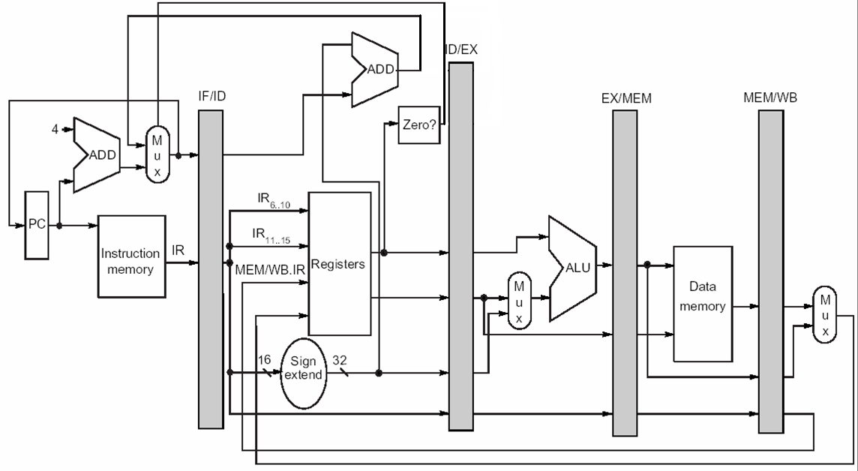
Control Hazards (4)
Reducing the stall from branch hazards by moving the zero test and branch calculation into ID phase of pipeline. It uses a separate adder to compute the branch target address during ID. Because the branch target addition happens during ID, it will happen for all instructions. The branch condition (Regs[IF/ID.IR6…10] op 0) will also be done for all instructions. The selection of the sequential PC or the branch target PC will still occur during IF, but now it uses values from ID phase, rather than from EX/MEM register. In this case, the branch instruction is done by the end of ID phase, so EX, MEM and WB stages are not used for branch instructions anymore.
Notes:
It uses a separate adder to compute the branch target address during ID. Because the branch target addition happens during ID, it will happen for all instructions. The branch condition (Regs[IF/ID.IR6…10] op 0) will also be done for all instructions. The selection of the sequential PC or the branch target PC will still occur during IF, but now it uses values from ID phase, rather than from EX/MEM register. In this case, the branch instruction is done by the end of ID phase, so EX, MEM and WB stages are not used for branch instructions anymore.

